Slide 1
Movie Search Engine
A searching engine by Michael and Phuong Anh

Slide 2
The Big Idea
What are the best movies?
Provide a simple interface that isn’t cluttered

Slide 3


How We Built It
Flask & Whoosh (BM25)
Bootstrap for styling
Jinja 2 & HTML for templating
Scraped using Beautiful Soup (from IMDB.com)

Slide 4
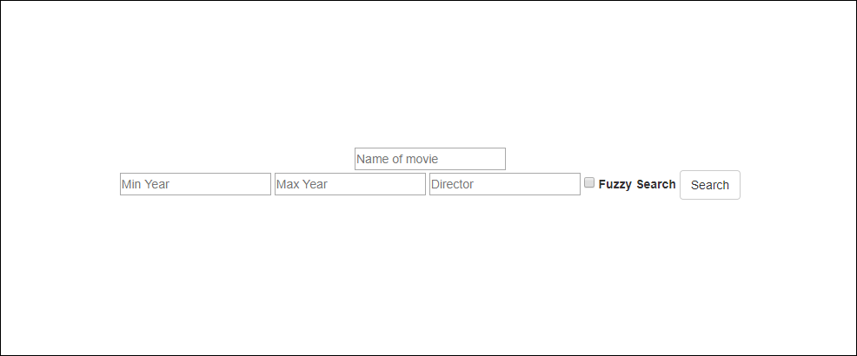
User interface

Slide 5
How Was The Data Stored?
CSV format
10000 movies
Whoosh schema & indexing
Title, Release Year, Director, Rating, Image(cover art),…

Slide 6
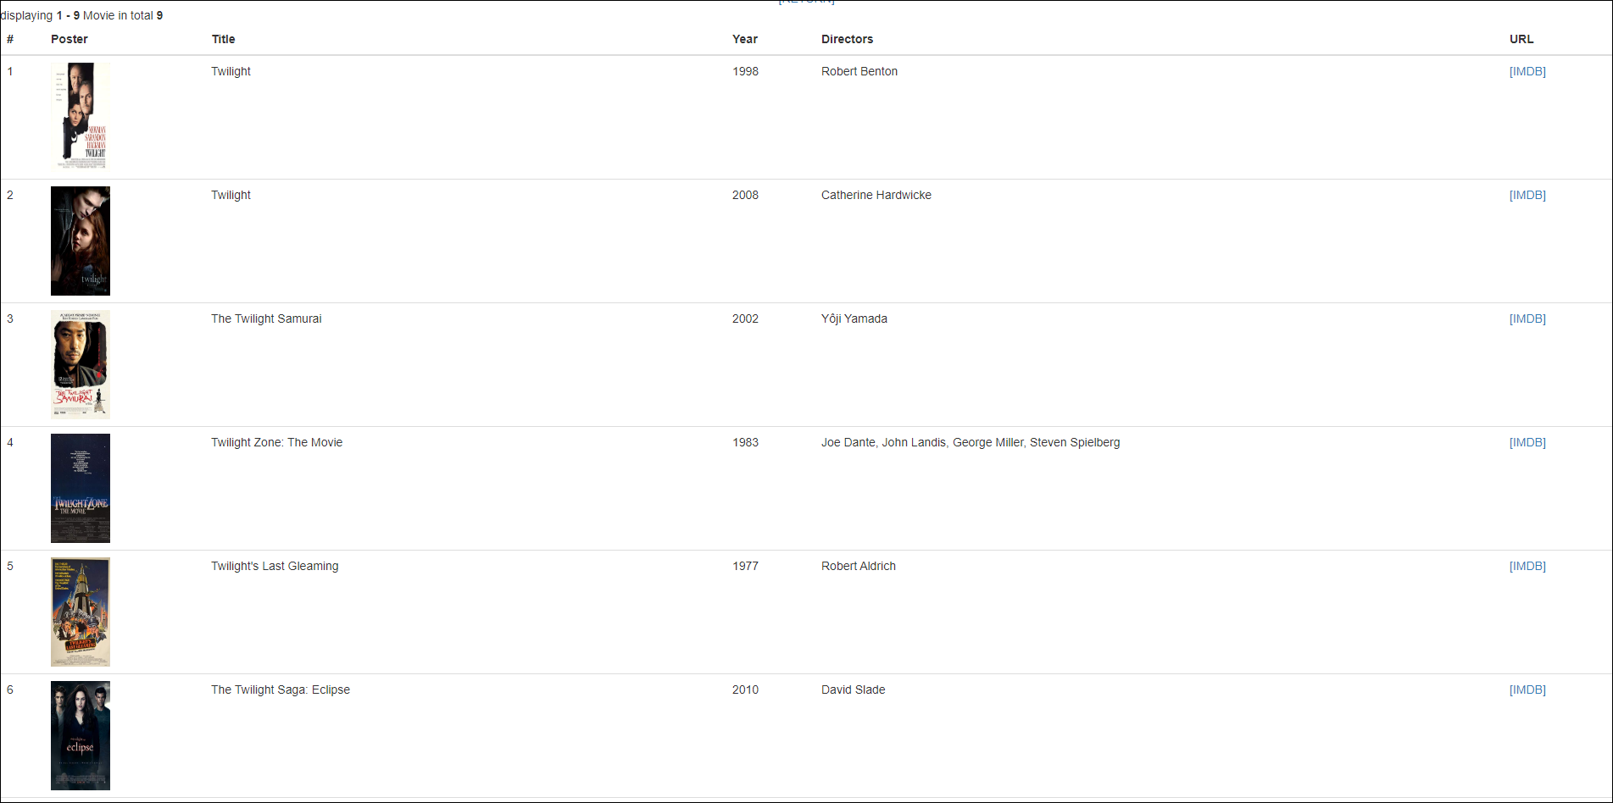
User Features
Images!
Year
Director
URL of movie
Filtering by year

Slide 7
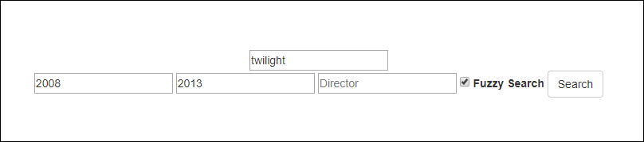
Fuzzy Search
Fuzzy search check box

Slide 8


